Slide 1

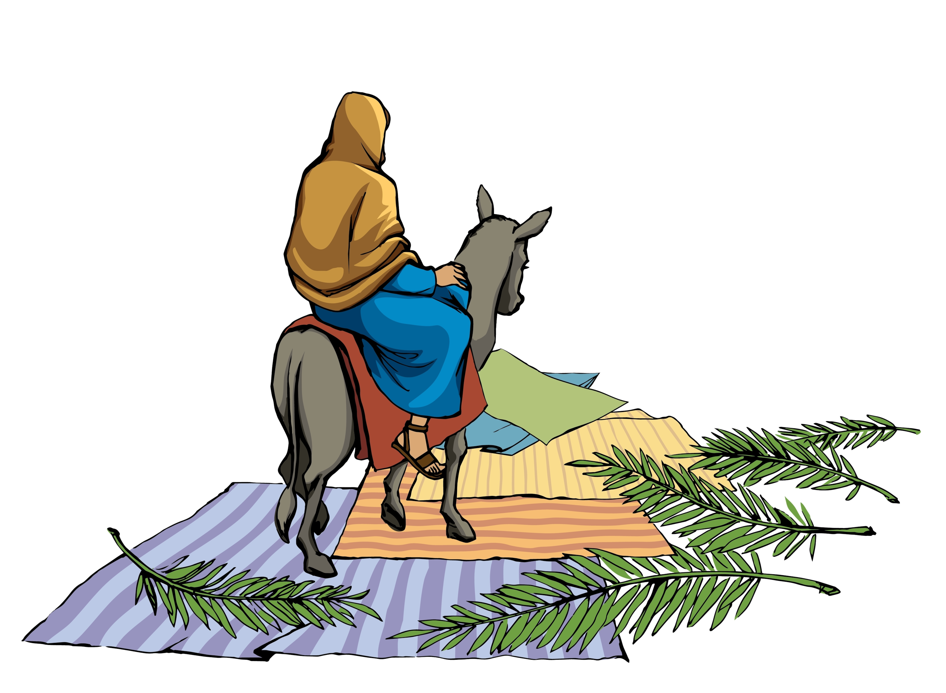
Look! Here comes Jesus
Riding on a donkey!
Hey! Here comes Jesus
Spread the word around!
Look! Here comes Jesus
Riding on a donkey!
Hey! Here comes Jesus
Visiting our town.
Wave your palm leaves
Wave your palm leaves
Wave your palm leaves in the sky!
Wave your palm leaves
Wave your palm leaves
As our promised King comes by!

Slide 2
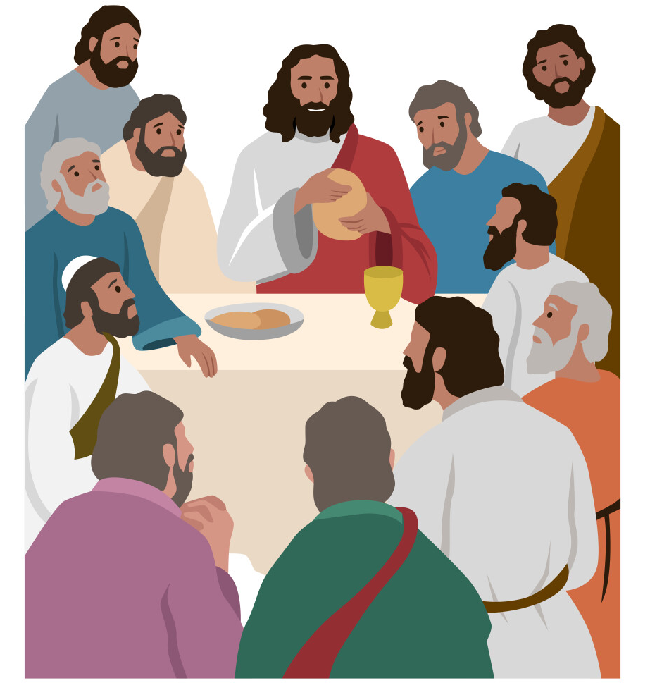
Jesus:
Every time you’re together
I’ll be there
May you, now and forever
Know My care
When you’re eating and drinking
Bread and wine
Keep My love and My sacrifice
In Mind
Instrumental
All: Repeat
Jesus: Keep My love and My sacrifice in mind.

Slide 3
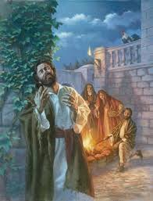
Peter:
I do not know Him!
What are you saying?
I’ve never seen this person before!
I do not know Him!
And I’m not staying
Don’t let me hear your voice anymore!
All:
Cock-a-doo-dle-doo!
Cock-a-doo-dle-doo!

Slide 4
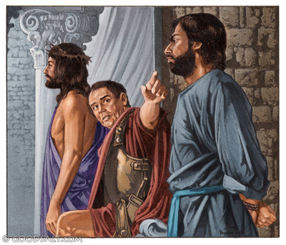
Crucify Him, He is the One:
Claimed that He is God’s only Son!
It’s Barabbas we want to save:
Jesus Christ can go to His grave!
We’re united
We’ve decided:
Crucify Him, that’s that!
Crucify Him, we will not grieve!
It’s our choice, so grant no reprieve!
Jesus Christ has failed to impress:
Frankly, we’ve lost all interest!
We’re united
We’ve decided:
Crucify Him, that’s that!
Crucify Him, that’s that!

Slide 5
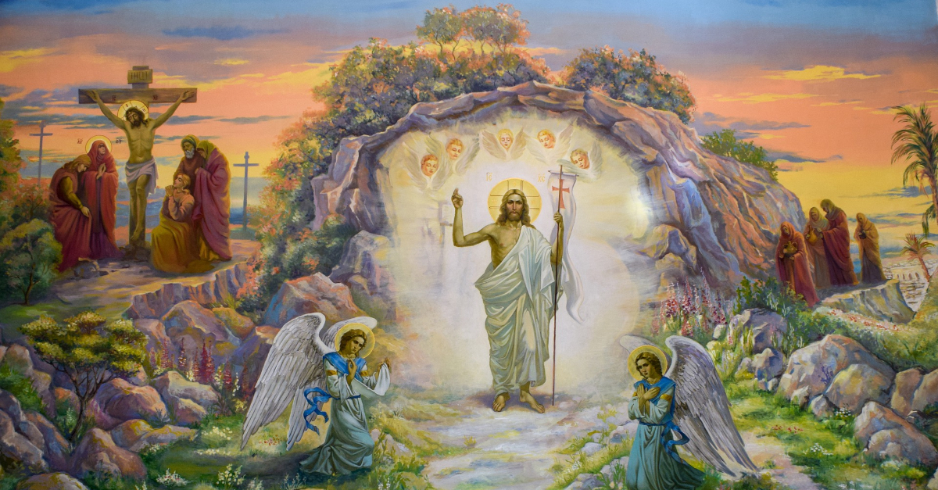
Jump for joy and reach for the skies!
We have had the greatest surprise!
Twist and shout and reach for your toes!
Spread the word so everyone knows!
Let the celebrations begin
And let the Easter bells start to ring!
Jesus died and rose from the grave
So over life and death He’s the King!
*Hands and voices gladly we raise
Singing songs of praise!
*Hands and voices glady we raise
Hosts of heavenly angels ablaze!
On this very holiest of days
Sing our songs of praise!
Sing our songs of praise!
x2
Second verse:

